Slide 1
BOOSTING ALGORITHM

Slide 2
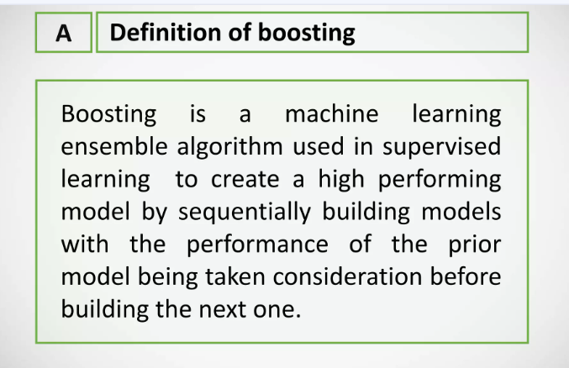

Slide 3
TYPES
ADA BOOST REGRESSOR
XG_BOOSTING
LG_BOOSTING

Slide 4
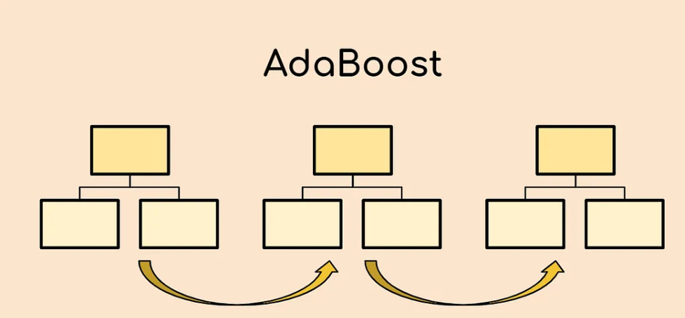
ADA BOOST REGRESSOR
It is a supervised learning algorithm that is used to classify data by combining multiple weak or base learners (e.g., decision trees) into a strong learner.
It reduce bias and variance.
We find depth for Decision tree ,adaboost takes only stumps.

Slide 5
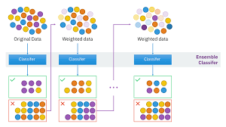

Slide 6
XG BOOSTING
This model is based on ‘Weak learner’
The trees are grown sequentially, with each tree learning from the mistakes of the previous tree. The final prediction is made by taking the average of the predictions from all of the trees in the ensemble.
One of the key advantages of XGBoost is its ability to handle missing data and large datasets efficiently.

Slide 7
LG BOOSTING
Faster training speed and accuracy resulting from LightGBM being a histogram-based algorithm that performs bucketing of values (also requires lesser memory).
Also compatible with large and complex datasets but is much faster during training.
Support for both parallel learning and GPU learning

